Slide 1

Applied Statistics with R
Day One
7th April 2021
Monday Osagie Adenomon, PhD, CStat, FRSS, FASI
1. Chair, IASC African Members Group
2. Founder, Foundation of Laboratory for Econometrics and Applied Statistics of Nigeria (aka FOUND-LEAS-IN-NIGERIA)
admonsagie@gmail.com

Slide 2
Introduction to R
R is a system for statistical analyses and graphics created by Ihaka & Gentleman (1996). R is both a software and a language considered as a dialect of the S language created by the AT&T Bell laboratories and is freely distributed under the terms of the GNU General Public License .
R is a language and environment for statistical computing and graphics, provides a wide variety of statistical methods (time series analysis, linear and nonlinear modeling, classical statistical tests, and so on) and graphical techniques, and is highly extensible.

Slide 3
Advantages of R
According to Paradis, (2005), the major advantages of R are
R has many functions and packages for statistical analyses and graphics
R language allows the user to program loops to successively analyze several data sets,
It is possible in R to combine in a single program different statistical functions to perform more complex analysis.

Slide 4
R is especially power for data manipulation, calculations and plots. Its features include:
An integrated and very well-conceived documentation system.
Efficient procedures for data treatment and storage.
A vast and coherent collection of statistical procedures for data analysis
A suit of operators for calculations on tables, especially matrices
Advanced graphical capabilities.
A simple and Efficient programming language, including conditioning, loops, recursion, and input-output possibilities.

Slide 5
R download
R setup can be downloaded from https://cran.r-project.org
As at today 16-09-2020 R. 4.0.2 for Windows and Mac
Another news says R.4.0.3
You can also download R studio from https://rstudio.com
You can down Tinn-R editor from https://tinn-r.soft112.com
Packages are install into R through online

Slide 6
Installing R on a Windows PC
To install R on the Windows computer, the following steps are to be followed:
1. Go to http://ftp.heanet.ie/mirrors/cran.r-project.org.
2. Under “Download and Install R”, click on the “Windows” link.
3. Under “Subdirectories”, click on the “base” link.
4. On the next page, there is a “Download R 3.2.0 for Windows” (or R.X.X.X, where X.X.X gives the version of R, eg. R 3.2.0). Click on this link.
5. You may be asked if you want to save or run a file “R-3.2.0-win32.exe”. Choose “Save” and save the file on the Desktop. Then double-click on the icon for the file to run it.
6. You choose language to install it in – e.g. English.
7. The R Setup Wizard will appear in a window. Click “Next” at the bottom of the R Setup wizard window.

Slide 7
8. The next page says “Information” at the top. Click “Next” again.
9. The next page says “Information” at the top. Click “Next” again.
10. The next page says “Select Destination Location” at the top. By default, it will suggest to install R in “C:\Program Files” on your computer.
11. Click “Next” at the bottom of the R Setup wizard window.
12. The next page says “Select components” at the top. Click “Next” again.
13. The next page says “Start-up options” at the top. Click “Next” again.
14. The next page says “Select start menu folder” at the top. Click “Next” again.
15. The next page says “Select additional tasks” at the top. Click “Next” again.
16. R should now be installed. This will take about a minute. When R has finished, you will see “Completing the R for Windows Setup Wizard” appear. Click “Finish”.

Slide 8
17. To start R, follow step 18 or 19:
18. Check if there is an “R” icon on the desktop of the computer that you are using. If so, double-click on the “R” icon to start R. If the “R” icon did not appear, try step 19 instead.
19. Click on the “Start” button at the bottom left of the computer screen, and then choose “All programs”, and start R by selecting “R” (or R X.X.X, where X.X.X gives the version of R, eg. R 3.2.0) from the menu of programs.
20. The R console (a rectangle) should pop up a window similar to the following:

Slide 9
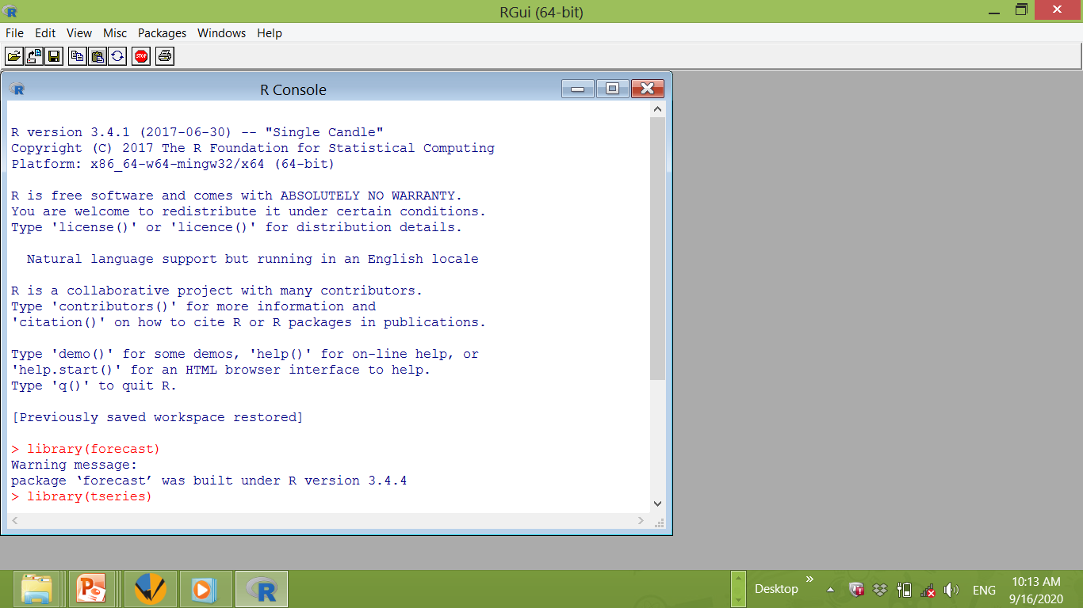
R Console

Slide 10
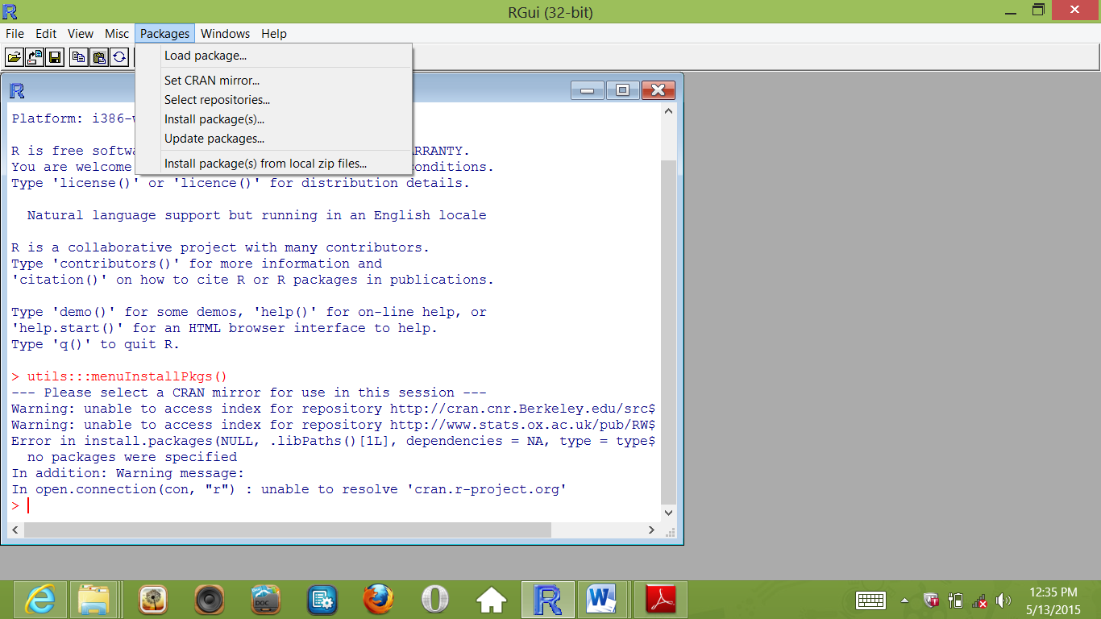
How to load or install packages
First to load package in R you do the following
Click on packages and then click on load package

Slide 11
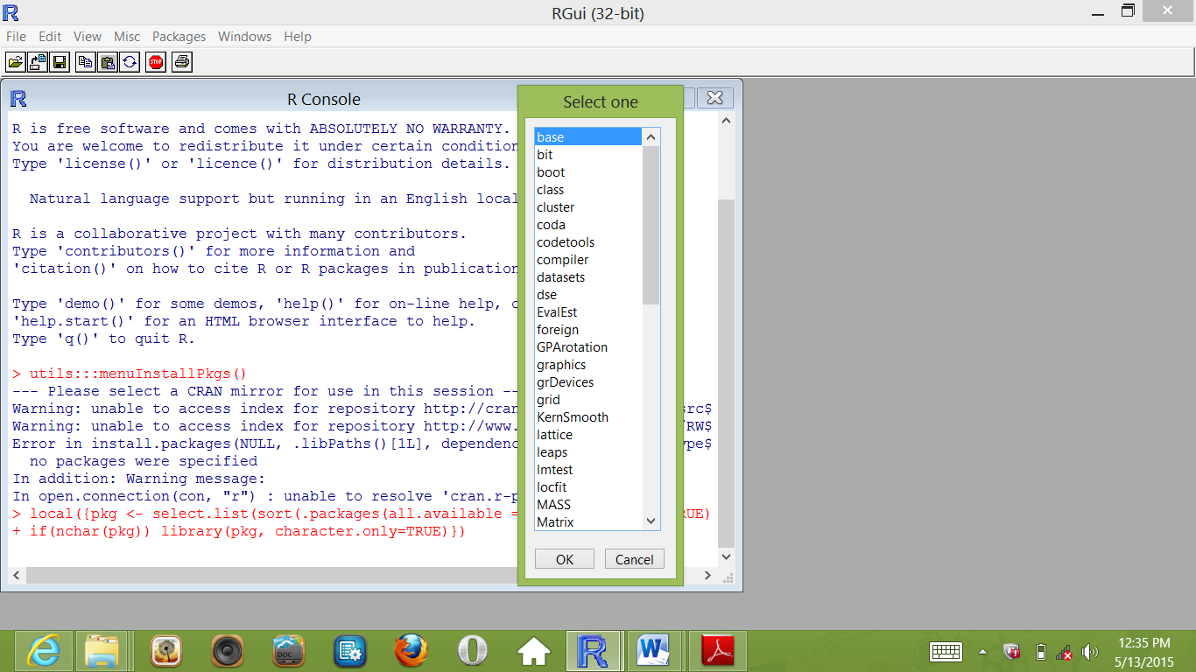
Select the appropriate package of your choice by scrolling up or down

Slide 12
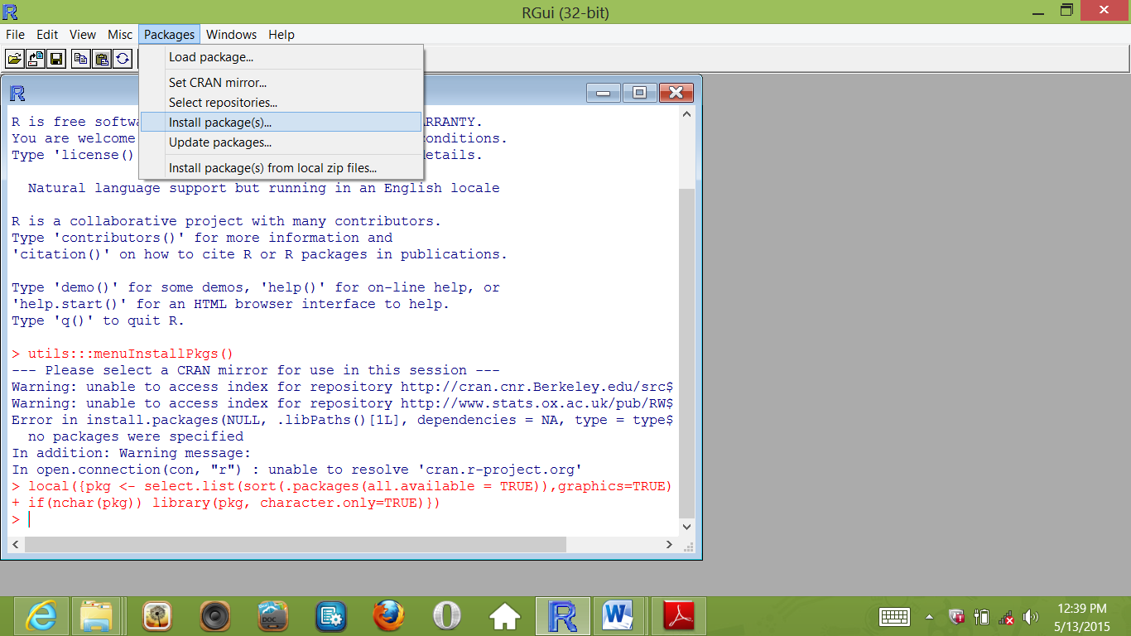
Then to install packages you must first be connected to the internet. Then click on packages and click on install packages as seen below

Slide 13
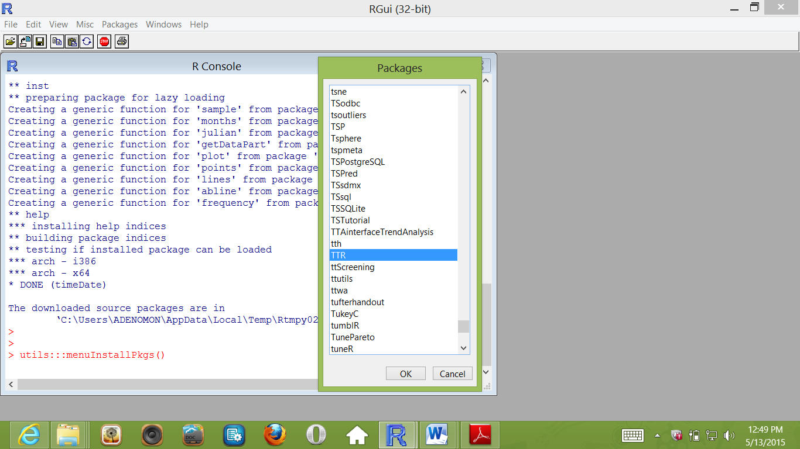
Then click the appropriate repository link and select the packages to install and click OK as seen below.

Slide 14
Sample R Packages
fBasics
grDevices
lattice
lmtest
mctest
boot
car
multcomp
forecast
zoo
agricolae

Slide 15
Data entry in R: Directly
Illustrations
Oyejola & Adebayo (2004): Suppose that in the enumeration from farms, the yields of groundnut from 40 farms expressed in kg/ha are as given below:
699 662 599 545 613 627 681 595 522 701
595 627 599 746 590 708 533 763 631 577
636 636 686 640 663 672 636 695 623 698
686 681 636 636 586 722 681 636 717 654

Slide 16
Enter the data in R as follows
yield<-c(699,662,599,545,613,627,681,595,522,701,595,627,599,746,590,708,533,763,631,577,636,636,686,640,663,672,636,695,623,698,686,681,636,636,586,722,681,636,717,654)
To present the data in the form of table, that is, to show the values and their respective frequencies. We use the codes below
counts<-table(yield)
counts
yield
522 533 545 577 586 590 595 599 613 623 627 631 636 640 654 662 663 672 681 686
1 1 1 1 1 1 2 2 1 1 2 1 6 1 1 1 1 1 3 2
695 698 699 701 708 717 722 746 763
1 1 1 1 1 1 1 1 1

Slide 17
Histogram
Now to present the data using histogram is as follows:
hist(yield,xlim=c(500,800),las=1,breaks=5,xlab="yield of groundnut",main="Histogram of yield of groundut from 40 farms")

Slide 18
To plot the data using Bar chart, we use the code below:
barplot(counts,xlab="yield of groundnut",main="Bar Chart of yield of groundut from 40 farms")

Slide 19
Pie Chart

Slide 20
library(grDevices)
pie.frequency<-c(12,7,19,12)
names(pie.frequency)<-c("white","red","yellow","pink")
pie(pie.frequency,main="Pie Chart showing colours of flower")

Slide 21
Transformation of Data
yield<-c(699,662,599,545,613,627,681,595,522,701,595,627,599,746,590,708,533,763,631,577,636,636,686,640,663,672,636,695,623,698,686,681,636,636,586,722,681,636,717,654)
log(yield)
[1] 6.549651 6.495266 6.395262 6.300786 6.418365 6.440947 6.523562 6.388561
[9] 6.257668 6.552508 6.388561 6.440947 6.395262 6.614726 6.380123 6.562444
[17] 6.278521 6.637258 6.447306 6.357842 6.455199 6.455199 6.530878 6.461468
[25] 6.496775 6.510258 6.455199 6.543912 6.434547 6.548219 6.530878 6.523562
[33] 6.455199 6.455199 6.373320 6.582025 6.523562 6.455199 6.575076 6.483107

Slide 22
Read data into R: CSV File
data2014<-read.csv("C:/Users/ADENOMON/Desktop/data2014.csv",header=T)
data2014
crop Production14 LandArea14 Yield14
1 Maize 10790.60 5849.8000 1.845
2 Sorghum 6741.10 5401.7000 1.248
3 Rice 6769.00 3067.4400 2.207
4 Ginger 58.89 145.1800 0.406
5 Yam 46622.00 3067.7000 15.198
6 Groundnut 3413.10 2670.1300 1.278
7 Millet 1720.90 1500.2000 1.147
8 Cassava 53782.80 8976.9000 5.991
9 Cowpea 2160.90 3668.1000 0.589
10 Cotton 222.66 489.3000 0.455
11 Cocoyam 3273.00 838.2800 3.904
12 Benniseed 375.25 426.6716 0.879
13 Soybean 677.00 712.2000 0.951
14 Okro 2039.50 1844.8000 1.106
15 Onion 985.40 452.6000 2.177
16 Tomato 2143.50 531.6000 4.032

Slide 23
Read data into R: txt File
data12014<-read.table("C:/Users/ADENOMON/Desktop/data12014.txt",header=T)
data12014
crop Production14 LandArea14 Yield14
1 Maize 10790.60 5849.8000 1.845
2 Sorghum 6741.10 5401.7000 1.248
3 Rice 6769.00 3067.4400 2.207
4 Ginger 58.89 145.1800 0.406
5 Yam 46622.00 3067.7000 15.198
6 Groundnut 3413.10 2670.1300 1.278
7 Millet 1720.90 1500.2000 1.147
8 Cassava 53782.80 8976.9000 5.991
9 Cowpea 2160.90 3668.1000 0.589
10 Cotton 222.66 489.3000 0.455
11 Cocoyam 3273.00 838.2800 3.904
12 Benniseed 375.25 426.6716 0.879
13 Soybean 677.00 712.2000 0.951
14 Okro 2039.50 1844.8000 1.106
15 Onion 985.40 452.6000 2.177
16 Tomato 2143.50 531.6000 4.032

Slide 24
Reading a Time series data: CSV
Fisher<-ts(read.csv("C:/Users/ADENOMON/Desktop/Fishing.csv",header=T),start=c(2008,1))
Fisher
Time Series:
Start = 2008
End = 2015
Frequency = 1
Full.Time Part.Time Occasional Total
2008 957918 689792 30595 1678305
2009 980715 706208 31694 1718617
2010 923150 562308 34169 1519627
2011 901889 565608 65615 1533112
2012 1014268 596696 68019 1678983
2013 963413 608805 71008 1643226
2014 860379 938343 122929 1921651
2015 740378 635044 81025 1456447

Slide 25
Normality test
yield<-c(699,662,599,545,613,627,681,595,522,701,595,627,599,746,590,708,533,763,631,577,636,636,686,640,663,672,636,695,623,698,686,681,636,636,586,722,681,636,717,654)
library(fBasics)
shapiroTest(yield)
jarqueberaTest(yield)

Slide 26
Title:
Shapiro - Wilk Normality Test
Test Results:
STATISTIC:
W: 0.9836
P VALUE:
0.8176
Description:
Wed Oct 14 01:23:48 2020 by user: ADENOMON

Slide 27
Title:
Jarque - Bera Normalality Test
Test Results:
STATISTIC:
X-squared: 0.3297
P VALUE:
Asymptotic p Value: 0.848
Description:
Wed Oct 14 01:25:22 2020 by user: ADENOMON

Slide 28
Regression and Correlation Analysis
crop15<-read.csv("C:/Users/ADENOMON/Desktop/crop2015.csv",header=T)
crop15
Production Land.Area Yield
1 10477.96 5741.88 1.825
2 6339.87 4964.83 1.277
3 7751.61 3150.02 2.461
4 61.70 162.87 0.379
5 47137.00 3179.73 14.824
6 3532.06 2566.33 1.376
7 1678.37 1446.10 1.161
8 57575.73 9170.80 6.278
9 2306.16 3635.74 0.634
10 179.11 428.67 0.418
11 3276.70 826.84 3.963
12 432.94 470.13 0.921
13 764.95 858.05 0.891
14 2067.89 1859.86 1.112
15 997.88 434.45 2.297
16 2208.32 557.50 3.961

Slide 29
Scatter plots
plot(crop15[,2],crop15[,1],main="Scatter plot of Production versus Land Area",xlab="Land Area",ylab="Production")

Slide 30
plot(crop15[,2],crop15[,3],main="Scatter plot of Yield versus Land Area",xlab="Land Area",ylab="Yield")

Slide 31
Correlation Analysis
To obtain correlation matrix of the data crop15. Note this is Product Moment correlation coefficients
cor(crop15)
Production Land.Area Yield
Production 1.0000000 0.7204726 0.7979924
Land.Area 0.7204726 1.0000000 0.2904894
Yield 0.7979924 0.2904894 1.0000000

Slide 32
Scatter plot matrix
plot(crop15)

Slide 33
Correlation Analysis with fBasics Package
library(fBasics)
correlationTest(crop15$Land.Area, crop15$Production, "pearson")
Title:
Pearson's Correlation Test
Test Results:
PARAMETER:
Degrees of Freedom: 14
SAMPLE ESTIMATES:
Correlation: 0.7205
STATISTIC:
t: 3.8873
P VALUE:
Alternative Two-Sided: 0.001642
Alternative Less: 0.9992
Alternative Greater: 0.0008212
CONFIDENCE INTERVAL:
Two-Sided: 0.3496, 0.8961
Less: -1, 0.8775
Greater: 0.4239, 1
Description:
Wed Oct 14 18:17:06 2020

Slide 34
correlationTest(crop15$Land.Area, crop15$Production, "kendall")
Title:
Kendall's tau Correlation Test
Test Results:
SAMPLE ESTIMATES:
tau: 0.75
STATISTIC:
z: 105
T | Exact: 105
P VALUE:
Alternative Two-Sided: 8.918e-06
Alternative Two-Sided | Exact: 8.918e-06
Alternative Less: 1
Alternative Less | Exact: 1
Alternative Greater: 4.459e-06
Alternative Greater | Exact: 4.459e-06
Description:
Wed Oct 14 18:22:14 2020

Slide 35
spearmanTest(crop15$Land.Area, crop15$Production)
Title:
Spearman's rho Correlation Test
Test Results:
SAMPLE ESTIMATES:
rho: 0.8794
STATISTIC:
S: 82
P VALUE:
Alternative Two-Sided: < 2.2e-16
Alternative Less: 1
Alternative Greater: < 2.2e-16
Description:
Wed Oct 14 18:26:07 2020

Slide 36
Regression Analysis: Linear & Robust
lreg<-lm(Land.Area~Production,data=crop15)
summary(lreg)
Call:
lm(formula = Production ~ Land.Area, data = crop15)
Residuals:
Min 1Q Median 3Q Max
-15334 -5170 414 2327 34392
Coefficients:
Estimate Std. Error t value Pr(>|t|)
(Intercept) -3159.609 4427.776 -0.714 0.48721
crop15$Land.Area 5.002 1.287 3.887 0.00164 **
---
Signif. codes: 0 ‘***’ 0.001 ‘**’ 0.01 ‘*’ 0.05 ‘.’ 0.1 ‘ ’ 1
Residual standard error: 12350 on 14 degrees of freedom
Multiple R-squared: 0.5191, Adjusted R-squared: 0.4847
F-statistic: 15.11 on 1 and 14 DF, p-value: 0.001642

Slide 37
ANOVA for Linear Regression
ANOVAreg<-aov(lreg)
summary(ANOVAreg)
Df Sum Sq Mean Sq F value Pr(>F)
Land.Area 1 2.306e+09 2.306e+09 15.11 0.00164 **
Residuals 14 2.137e+09 1.526e+08
---
Signif.codes: 0 ‘***’ 0.001 ‘**’ 0.01 ‘*’ 0.05 ‘.’ 0.1 ‘ ’ 1

Slide 38
Diagnostic Testing: Serial Correlation Testing
library(lmtest)
dwtest(lreg)
Durbin-Watson test
data: lreg
DW = 1.943, p-value = 0.4161
alternative hypothesis: true autocorrelation is greater than 0
bgtest(lreg)
Breusch-Godfrey test for serial correlation of order up to 1
data: lreg
LM test = 0.011081, df = 1, p-value = 0.9162

Slide 39
Test for Heteroscedasticity for Linear Regression
bptest(lreg)
studentized Breusch-Pagan test
data: lreg
BP = 1.9338, df = 1, p-value = 0.1643

Slide 40
Normality test of linear regression model
jarqueberaTest(lreg$residuals)
Title:
Jarque - Bera Normalality Test
Test Results:
STATISTIC:
X-squared: 9.5427
P VALUE:
Asymptotic p Value: 0.008469
Description:
Wed Oct 14 19:28:57 2020 by user: ADENOMON

Slide 41
Calculation of forecast statistic for linear regression using forecast package
library(forecast)
accuracy(crop15$Production,lreg$fitted.values)
ME RMSE MAE
Test set 7.673862e-13 11555.61 7620.39
MPE MAPE
75.23185 142.774

Slide 42
Robust Regression
robustreg<-rlm(Production~Land.Area,data=crop15,psi=psi.bisquare)
summary(robustreg)
Call: rlm(formula = crop15$Production ~ crop15$Land.Area, data = crop15,
psi = psi.bisquare)
Residuals:
Min 1Q Median 3Q Max
-3250.2 -585.3 -307.3 1799.2 43678.6
Coefficients:
Value Std. Error t value
(Intercept) 77.6888 638.6355 0.1216
crop15$Land.Area 1.5069 0.1856 8.1195
Residual standard error: 1507 on 14 degrees of freedom

Slide 43
Test of coefficients of Robust Regression
coeftest(robustreg)
z test of coefficients:
Estimate Std. Error z value Pr(>|z|)
(Intercept) 77.68876 638.63545 0.1216 0.9032
crop15$Land.Area 1.50689 0.18559 8.1195 4.681e-16 ***
---
Signif.codes: 0 ‘***’ 0.001 ‘**’ 0.01 ‘*’ 0.05 ‘.’ 0.1 ‘ ’ 1

Slide 44
Calculation of forecast statistic for robust regression using forecast package
accuracy(crop15$Production,robustreg$fitted.values)
ME RMSE MAE MPE Test set -5380.791 15259.5 6385.538 -75.20537
MAPE
123.2302

Slide 45
Normality test of Robust regression model
jarqueberaTest(robustreg$residuals)
Title:
Jarque - Bera Normalality Test
Test Results:
STATISTIC:
X-squared: 19.386
P VALUE:
Asymptotic p Value: 6.171e-05
Description:
Wed Oct 14 19:31:33 2020 by user: ADENOMON

Slide 46
Analysis of Variance (ANOVA)
ANOVA is used to compare three or more samples
Note here
ANOVA is quite robust to small deviations from normality
Normal test are sometimes quite conservative meaning normality may be rejected due to a limited deviation from normality.
Assumptions
Variable type
Independence
Normality
Equality of Variance
Notes
If Variances are equal, use ANOVA
If Variances not equal, use Welch Test
If normality is not assumed, use Kruskal Wallis Test

Slide 47
Illustration of One Way ANOVA
Nineteen pigs are assigned at random among four experimental groups. Each group is fed a different diet. The data are pig body weights in kilograms, after being raised on these diet. We wish to ask whether the pig weights are the same for all four diets.
Feed 1 Feed 2 Feed 3 Feed 4
60.8 68.7 102.6 87.9
57.0 67.7 102.1 84.2
65.0 74.0 100.2 83.1
58.6 66. 3 96.5 85.7
61.7 69.8 90. 3
In the example above, the feeds are the treatment, which is a
typical example one-way analysis of variance.

Slide 48
Response<-c(60.8, 57, 65, 58.6, 61.7, 68.7, 67.7, 74, 66.3, 69.8, 102.6, 102.1, 100.2, 96.5, 87.9, 84.2, 83.1, 85.7, 90.3)
Trt<-c(rep("F1",5),rep("F2",5),rep("F3",4),rep("F4",5))
boxplot(Response~Trt,main=“Boxplot of four diets for Pigs”)

Slide 49
Levene's Test for Homogeneity of Variance
library(car)
leveneTest(Response~Trt)
Levene's Test for Homogeneity of Variance (center = median)
Df F value Pr(>F)
group 3 0.0238 0.9948
15
Warning message:
In leveneTest.default(y = y, group = group, ...) : group coerced to factor.
Since p-value=0.9948>0.05, we do not reject H_{o} we conclude that the variances are equal (Homogenous)

Slide 50
One way ANOVA
Oneway<-aov(Response~Trt)
summary(Oneway)
Df Sum Sq Mean Sq F value Pr(>F)
Trt 3 4226 1408.8 164.6 1.06e-11 ***
Residuals 15 128 8.6
---
Signif.codes: 0 ‘***’ 0.001 ‘**’ 0.01 ‘*’ 0.05 ‘.’ 0.1 ‘ ’ 1

Slide 51
Post ANOVA Test: One Way
library(multcomp)
TukeyHSD(Oneway)
Tukey multiple comparisons of means
95% family-wise confidence level
Fit: aov(formula = Response ~ Trt)
$Trt
diff lwr upr p adj
F2-F1 8.68 3.347895 14.012105 0.0014725
F3-F1 39.73 34.074449 45.385551 0.0000000
F4-F1 25.62 20.287895 30.952105 0.0000000
F3-F2 31.05 25.394449 36.705551 0.0000000
F4-F2 16.94 11.607895 22.272105 0.0000009
F4-F3 -14.11 -19.765551 -8.454449 0.0000168

Slide 52
LSD Post ANOVA Test
LSD.test(Oneway,"Trt",p.adj="bonferroni")
plot(LSD.test(Oneway,"Trt",p.adj="bonferroni")

Slide 53
print(LSD.test(Oneway,"Trt",p.adj="bonferroni"))
$statistics
MSerror Df Mean CV
8.556667 15 78.01053 3.749722
$parameters
test p.ajusted name.t ntr alpha
Fisher-LSD bonferroni Trt 4 0.05
$means
Response std r LCL UCL Min Max Q25 Q50 Q75
F1 60.62 3.064637 5 57.83168 63.40832 57.0 65.0 58.600 60.80 61.700
F2 69.30 2.926602 5 66.51168 72.08832 66.3 74.0 67.700 68.70 69.800
F3 100.35 2.767068 4 97.23257 103.46743 96.5 102.6 99.275 101.15 102.225
F4 86.24 2.896204 5 83.45168 89.02832 83.1 90.3 84.200 85.70 87.900

Slide 54
$comparison
NULL
$groups
Response groups
F3 100.35 a
F4 86.24 b
F2 69.30 c
F1 60.62 d

Slide 55
Duncan Post Anova Test
duncan.test(Oneway,"Trt")
print(duncan.test(Oneway,"Trt"))
$statistics
MSerror Df Mean CV
8.556667 15 78.01053 3.749722
$parameters
test name.t ntr alpha
Duncan Trt 4 0.05
$duncan
NULL
$means
Response std r Min Max Q25 Q50 Q75
F1 60.62 3.064637 5 57.0 65.0 58.600 60.80 61.700
F2 69.30 2.926602 5 66.3 74.0 67.700 68.70 69.800
F3 100.35 2.767068 4 96.5 102.6 99.275 101.15 102.225
F4 86.24 2.896204 5 83.1 90.3 84.200 85.70 87.900

Slide 56
$comparison
NULL
$groups
Response groups
F3 100.35 a
F4 86.24 b
F2 69.30 c
F1 60.62 d

Slide 57
Normality test of Residuals of One way ANOVA
library(fBasics)
jarqueberaTest(Oneway$residuals)
Title:
Jarque - Bera Normalality Test
Test Results:
STATISTIC:
X-squared: 0.9568
P VALUE:
Asymptotic p Value: 0.6198
Description:
Wed Oct 14 23:37:53 2020 by user: ADENOMON

Slide 58
Two Way ANOVA
We wish to perform a two way ANOVA considering the treatment (the feeds) and the blocking effects.
Blocks Feed 1 Feed 2 Feed 3 Feed 4
1 60.8 68.7 102.6 87.9
2 57.0 67.7 102.1 84.2
3 65.0 74.0 100.2 83.1
4 58.6 66.3 96.5 85.7
5 61.7 69.8 100 90.3
Here we have 5 blocks and 4 treatments. The R code is as

Slide 59
Response<-c(60.8, 57, 65, 58.6, 61.7, 68.7, 67.7, 74, 66.3, 69.8, 102.6, 102.1, 100.2, 96.5, 100, 87.9, 84.2, 83.1, 85.7, 90.3)
Trt<-c(rep("F1",5),rep("F2",5),rep("F3",5),rep("F4",5))
Blk<-c("1","2","3","4","5","1","2","3","4","5","1","2","3","4","5","1","2","3","4","5")
Twoway<-aov(Response~Trt+Blk)
summary(Twoway)
Df Sum Sq Mean Sq F value Pr(>F)
Trt 3 4686 1561.9 233.391 6.66e-11 ***
Blk 4 48 12.0 1.799 0.194
Residuals 12 80 6.7
---
Signif. codes: 0 ‘***’ 0.001 ‘**’ 0.01 ‘*’ 0.05 ‘.’ 0.1 ‘ ’ 1

Slide 60
Post ANOVA test: Two way
TukeyHSD(Twoway)
Tukey multiple comparisons of means
95% family-wise confidence level
Fit: aov(formula = Response ~ Trt + Blk)
$Trt
diff lwr upr p adj
F2-F1 8.68 3.822572 13.537428 0.0009262
F3-F1 39.66 34.802572 44.517428 0.0000000
F4-F1 25.62 20.762572 30.477428 0.0000000
F3-F2 30.98 26.122572 35.837428 0.0000000
F4-F2 16.94 12.082572 21.797428 0.0000013
F4-F3 -14.04 -18.897428 -9.182572 0.0000095
$Blk
diff lwr upr p adj
2-1 -2.250 -8.080511 3.580511 0.7352446
3-1 0.575 -5.255511 6.405511 0.9975718
4-1 -3.225 -9.055511 2.605511 0.4355998
5-1 0.450 -5.380511 6.280511 0.9990675
3-2 2.825 -3.005511 8.655511 0.5557675
4-2 -0.975 -6.805511 4.855511 0.9820403
5-2 2.700 -3.130511 8.530511 0.5950581
4-3 -3.800 -9.630511 2.030511 0.2898145
5-3 -0.125 -5.955511 5.705511 0.9999943
5-4 3.675 -2.155511 9.505511 0.3182459

Slide 61
Duncan Test: Two way
print(duncan.test(Twoway,"Trt"))
$statistics
MSerror Df Mean CV
6.692083 12 79.11 3.270012
$parameters
test name.t ntr alpha
Duncan Trt 4 0.05
$duncan
Table CriticalRange
2 3.081307 3.564762
3 3.225244 3.731283
4 3.312453 3.832176
$means
Response std r Min Max Q25 Q50 Q75
F1 60.62 3.064637 5 57.0 65.0 58.6 60.8 61.7
F2 69.30 2.926602 5 66.3 74.0 67.7 68.7 69.8
F3 100.28 2.401458 5 96.5 102.6 100.0 100.2 102.1
F4 86.24 2.896204 5 83.1 90.3 84.2 85.7 87.9
$comparison
NULL
$groups
Response groups
F3 100.28 a
F4 86.24 b
F2 69.30 c
F1 60.62 d

Slide 62
print(duncan.test(Twoway,"Blk"))
$statistics
MSerror Df Mean CV
6.692083 12 79.11 3.270012
$parameters
test name.t ntr alpha
Duncan Blk 5 0.05
$duncan
Table CriticalRange
2 3.081307 3.985526
3 3.225244 4.171701
4 3.312453 4.284503
5 3.370172 4.359159
$means
Response std r Min Max Q25 Q50 Q75
1 80.000 18.88121 4 60.8 102.6 66.725 78.30 91.575
2 77.750 19.71539 4 57.0 102.1 65.025 75.95 88.675
3 80.575 15.02584 4 65.0 100.2 71.750 78.55 87.375
4 76.775 17.40486 4 58.6 96.5 64.375 76.00 88.400
5 80.450 17.74082 4 61.7 100.0 67.775 80.05 92.725
$comparison
NULL
$groups
Response groups
3 80.575 a
5 80.450 a
1 80.000 a
2 77.750 a
4 76.775 a

Slide 63
Normality test for residuals: Two way
library(fBasics)
jarqueberaTest(Twoway$residuals)
Title:
Jarque - Bera Normalality Test
Test Results:
STATISTIC:
X-squared: 0.1089
P VALUE:
Asymptotic p Value: 0.947
Description:
Thu Oct 15 01:36:55 2020 by user: ADENOMON

Slide 64
THANK
YOU

